Slide 1
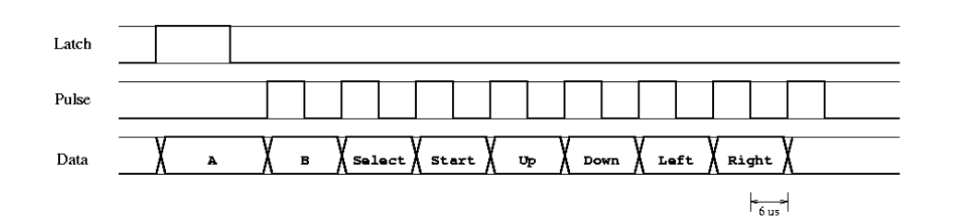
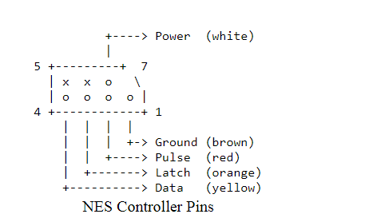
NES controller introduction
Need +5V power source
Frequency: 60 Hz
Problem: FPGA is 3.3V based…
Documentation: https://tresi.github.io/nes/

Slide 2
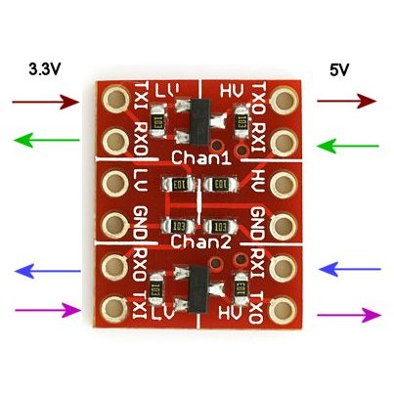
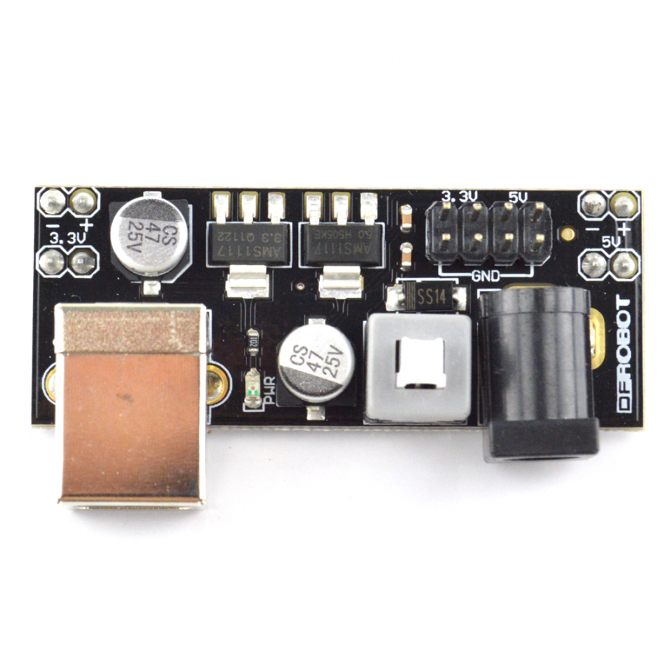
Solution!
BOB-08745 Level Converter
not needed? See next slide
Breadboard power supply kit
5 volts needed to power SNES controller
Can use USB cord to supply 5 volts to this board
Could we somehow just break out the 5 volts
from the USB cable, and skip this board?
see slide 4

Slide 3
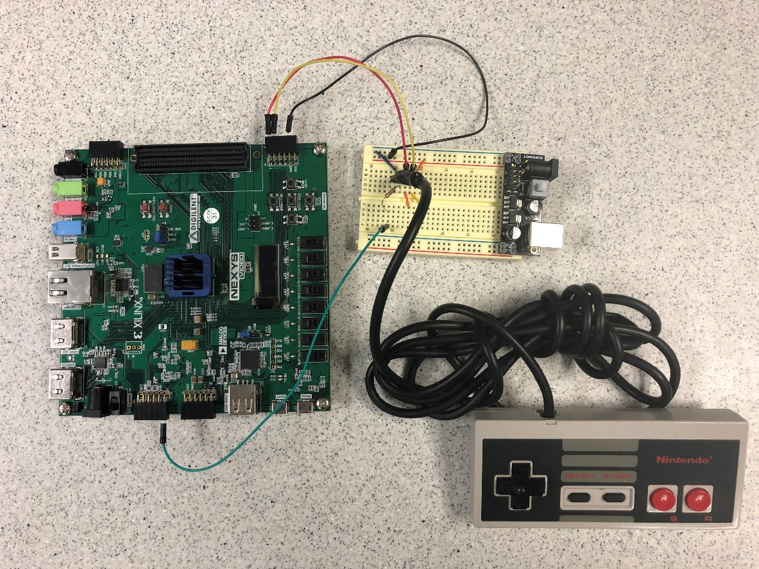
NES Controller
Found we did not need the Level Converter board
Used 120 ohm resistor between the SNES 5 volt Data pin and the FPGA 3 volt input pin
Just hooked the FGPA 3 volt output pins directly to the SNES 5 volt latch and pulse input pins, and it worked

Slide 4
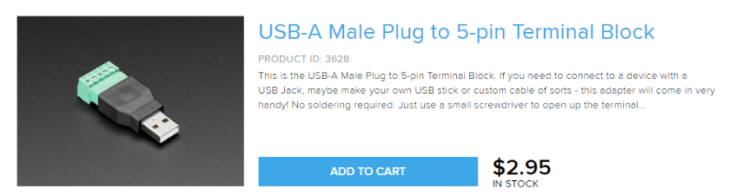
Could this provide your 5 Volts power, without the extra board?
Be careful not to short out your USB supply or laptop USB port

Slide 5
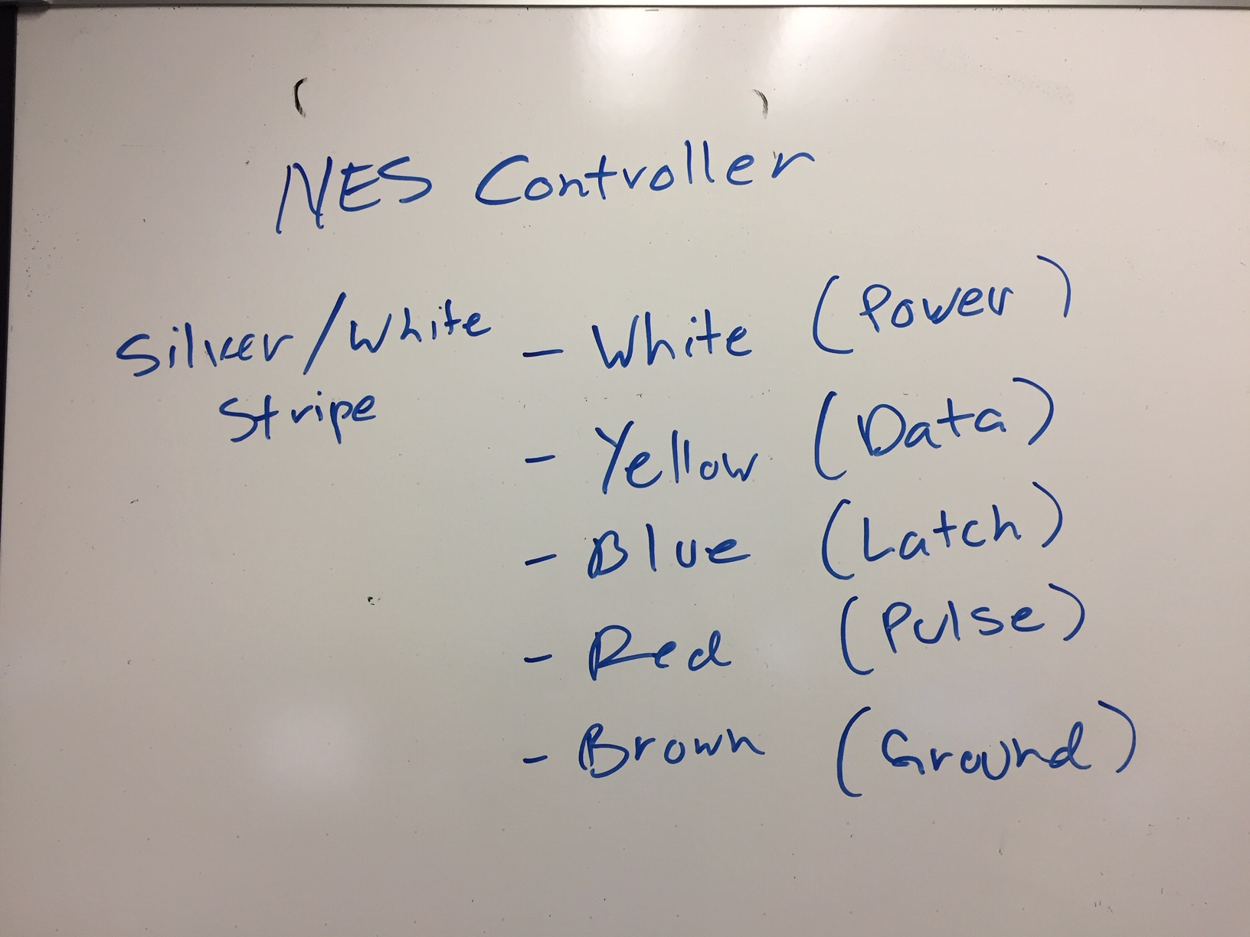

Slide 6
Detailed Design
Detailed design of the datapath and FSM.
Key players: BRAM, FSM, and video modules
Module | snake_datapath.vhd (FPGA hardware)
Inputs | flagClear – reg14 (1 bit) SoundEn – reg1 (1 bit) Dot1en – reg2 (1 bit) Dot2en – reg3 (1 bit) Dot1x – reg4 (10 bits) Dot1y – reg5 (10 bits) Dot2x – reg6 (10 bits) Dot2y – reg7 (10 bits) Plen – reg8 (1 bit) P2en – reg9 (1 bit) P1x – reg10 (5 bits) P1y – reg11 (32 bits) P2x – reg12 (5 bits) P2y – reg13 (32 bits) Data signal from NES → ja(3)
Outputs | Latch signal to NES → ja(1) Pulse signal to NES → ja(2) NESready signal to SDK (interrupt purposes) NES button to SDK NES button to LEDs
Behavior | The datapath is the main unit that contains majority of the sub-modules and vhdl code necessary to draw snake blocks on the correct, specified location on the monitor. Basically, the datapath takes in a block location from MicroBlaze and draws a block on the specified location with the help of BRAM and oscilloscope modules implementation.

Slide 7
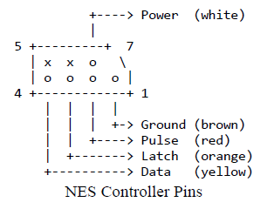
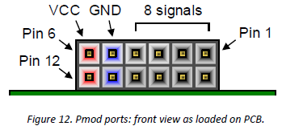
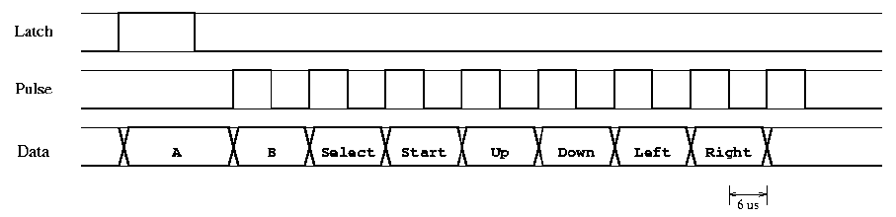
Detailed Design
NES controller requires two signals generation in order respond with button press.
Must follow timing diagram.

Slide 8
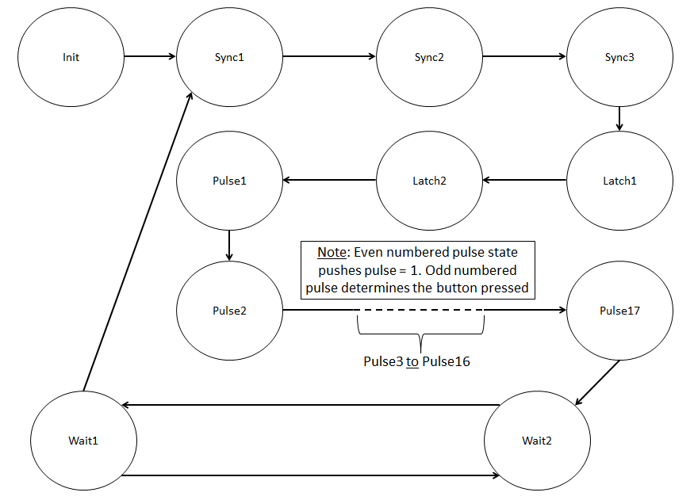
Detailed Design
The one and only objective of the FSM is to generate the latch and pulse and detect data from NES.
Utilize a counter to create half-cycle delays

Slide 9
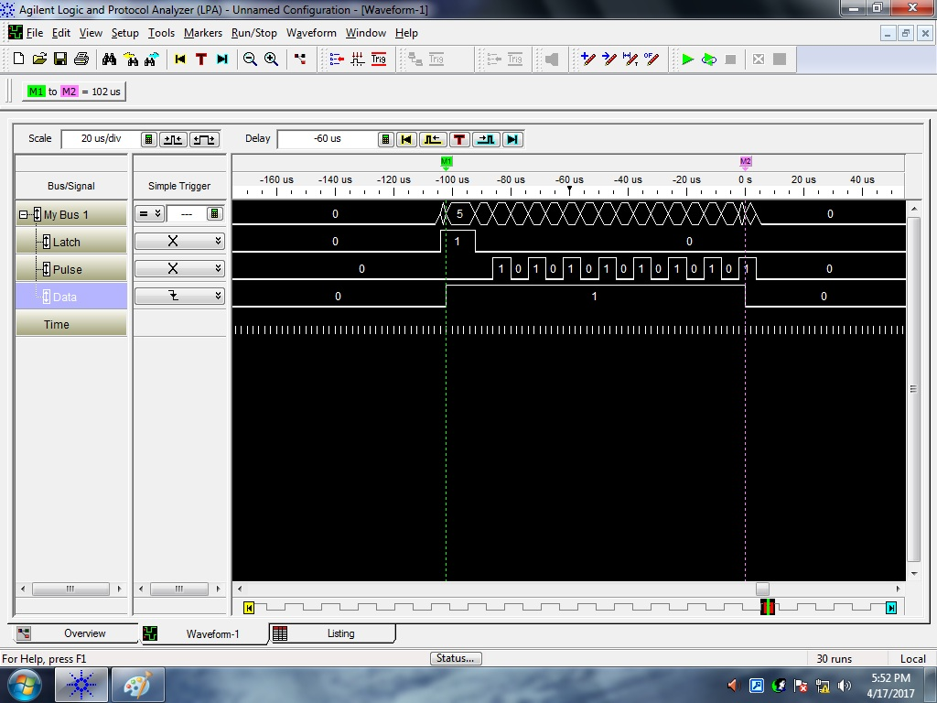
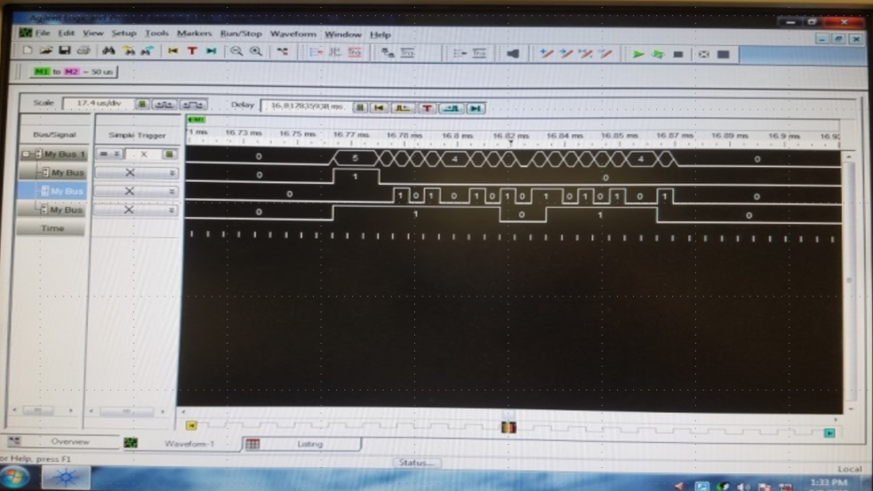
Detailed Design
Utilize logic analyzer to verify signal generation and that NES is responding.
Utilize LED to verify as well.

